Slide 1
FunGamesInc. Presents: Connect Four (With Networking)
By: Vishwa Kode
Joseph Thomas
Anshuman Dikhit

Slide 2
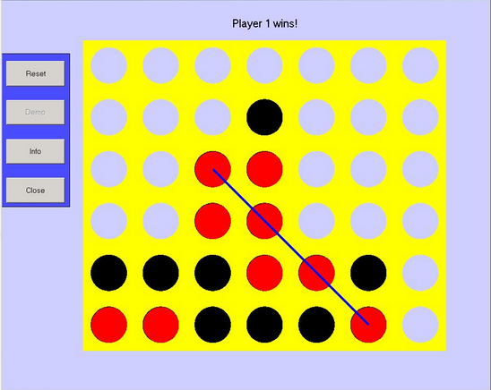
What is Connect Four?
Classic Two Player Strategy Game Created By Howard Wesler
Drop Chips into Grid
First to four consecutive chips wins
Played on 6x7 Grid
Rules:
Player 1 goes first
Alternate dropping pieces
First to four consecutive chips wins

Slide 3
What’s Different?
Our Connect Four played on Grid World Interface
Has Easy, Medium, Hard AI Options
Can Play With Friends Online Using Networked Connect Four

Slide 4
Responsibilities
Vishwa Kode (Project Lead) | Joseph Thomas | Anshuman Dikhit
-Classes: -Piece -PieceDisplay -ConnectPlayer -Prioritize -Connect Runner -Documentation -Specifications -JUnit Testing -Project Write Up and Power Point Presentation | -Classes: - EasyAI -MediumAI -HardAI -ConnectWorld -Documentation -Specifications -Junit Testing -Final Project Write Up | -Classes: -Board -Networking -PowerPoint -Final Project Write Up

Slide 5
Hard AI Implementation
Uses Prioritize to rate different locations on the board
Rates by looking at chains of chips
Picks locations with the longest chain of chips
Makes sure to block opponent

Slide 6
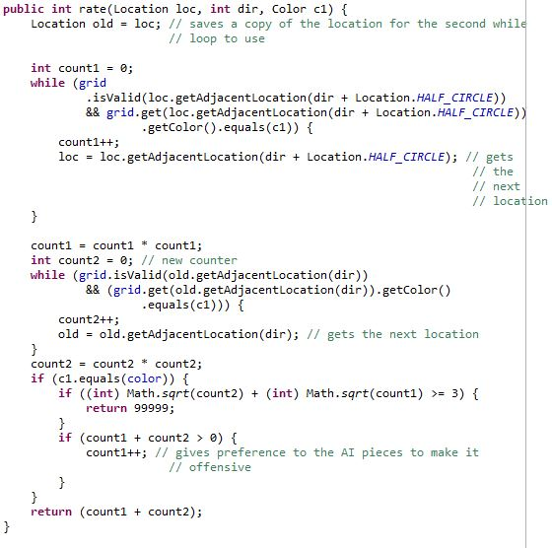

Slide 7
Medium AI Implementation
Works the same as Hard AI except a little differently
Doesn’t always make the move with the best rating

Slide 8
Easy AI Implementation
Checks the list of allowed moves
Randomly makes a move

Slide 9
Human Player Implementation
Checks where the user clicks
Places the piece in the lowest part of the column

Slide 10
Non-Hierarchical Classes

Slide 11
Game Implementation
Runs the game until it detects a win
Sets game up based on selected difficulty
Outputs messages at the top of gridworld

Slide 12
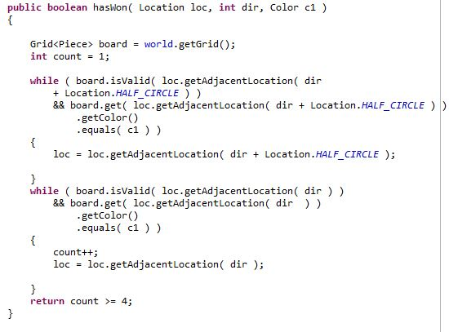
ConnectGame Code

Slide 13
Runner Implementation
Asks the user to input difficulty or to quit
Runs game till it has been won or ended in a tie

Slide 14
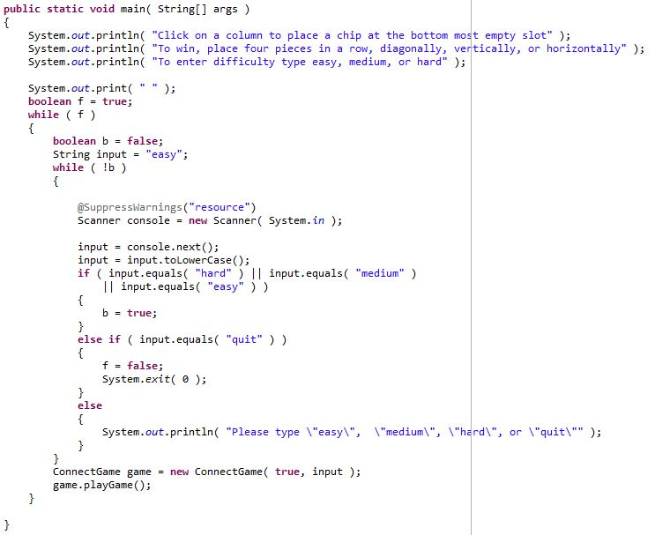

Slide 15
What Is Networking?

Slide 16
How We Implemented Networking

Slide 17
Networking Code

Slide 18
Developmental Timeline

Slide 19
Technical Requirements
Eclipe Java Development Toolkit Installed
Java Development Kit 6.0 or Higher Installed
1GB of RAM or more

Slide 20
Installation Instructions Against AI
Import Connect4 File Into Eclipse
Open Connect4 Project
Hit Play button (Green Button With Arrow)
Enter Level of Difficulty
Enjoy the Game

Slide 21
Installation Instructions for Networking

Slide 22
Why Our Connect Four Game?
Improve Critical Thinking and Strategy
Develop Skill Level at Connect Four
Classic Game for all ages
Very Fun Game to play when Bored
Can Play with anyone in the world

Slide 23
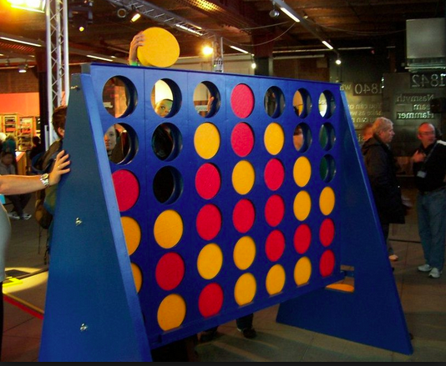
Thanks For Listening

